Slide 1

How To Create Tests
Tutorial
Notes:
In the previous section, we identified our functional requirements and categorised them into 4 groups. In this tutorial, we’ll learn how to create tests for each of these groups.

Slide 2
Setup
Decide on a programming language (python, java, etc.)
Install a testing framework for unit tests (pytest, jest, etc.)
Why use a testing framework?
Simplifies the creation, execution and maintenance of tests
Built-in reporting tools that generate detailed summaries
Easily integrated into CI/CD pipelines
Notes:
Before we can write any tests, you need to decide on a programming language and testing framework in order to write and run any tests easily.
In the code snippets I display on screen, Python and pytest will be used as the testing framework.
Why use a testing framework?
Provide a structured environment that simplifies the creation, execution and maintenance of automated testing
Frameworks often include built-in reporting tools that generate detailed summaries and details about test failures.
Designed to be easily integrated into CI/CD pipelines, ensuring testing automation where developers can catch bugs before it reaches production

Slide 3
Functional Requirements
Arithmetic Calculations:
Perform basic arithmetic functions:
Perform addition
Perform subtraction
Perform multiplication
Perform division
Input Handling:
Accept input
Input must be 1 or 2 digits
Input must contain valid hexadecimal numbers
Input must include a valid operator (+, -, /, *)
Output Handling:
Return and display output
Output must be less than 5 digits (<=4)
Output must not be negative
Output must not contain decimal places
Error Handling:
Invalid hexadecimal input must return an error
Missing or invalid operator must return an error
Input exceeding 2 digits must return an error
Division by zero must return an error Output that is greater than 4 digits will return an error
Output that is negative will return an error
Output with decimal places will return an error
Notes:
Now we are going to write our first test cases.
Before we write a single line of test code, I want to show you something
Important, and that is how our functional requirements from Section 1
map directly into our test file structure.
If you look at Section 1, we grouped our requirements into categories:
- Input handling
- Arithmetic operations
- Output constraints
- Error handling
Each of those categories becomes a test class in pytest.
Each requirement inside that category becomes two or more test functions, as we have to test for the success and failure cases for each.
Now let us see how this will look like in practice.

Slide 4
Steps for each test case
Arrange
Setup the inputs needed
Act
Call the function being tested
Assert
Check the result is what you expect
Notes:
Before we write tests, let me explain what a test actually is in three steps: arrange, act, assert.
Arrange: set up the inputs you need
Act: call the function you are testing
Assert: check the result is what you expected
As an additional step when beginning, the name of each test must be describe what is being tested.
Let’s use these steps for test case.

Slide 5
Testing: Arithmetic Calculations
Perform basic arithmetic functions:
Perform addition
Perform subtraction
Perform multiplication
Perform division
Notes:
Looking at our first category from our functional requirements, each of these points listed will have a success and failure test case.
For now the failure test cases will be discussed later on in the error handling section.

Slide 6

Testing: Arithmetic Calculations
Arrange
Notes:
Looking at addition, lets start with the first step: arrange
This is a pretty simple step, where we just identify the input that should result in a successful test case.
Next: Act
This is where we call the perform_addition function that will use the inputs we identified.

Slide 7

Testing: Arithmetic Calculations
Act
Notes:
Looking at addition, lets start with the first step: arrange
This is a pretty simple step, where we just identify the input that should result in a successful test case.
Next: Act
This is where we call the perform_addition function that will use the inputs we identified.

Slide 8

Testing: Arithmetic Calculations
Assert
Notes:
Lastly, Assert
This is where check if the result from the function we called is correct. For this test case, 1+1 has to equal 2.
That is it. Three lines of logic.
The test passes if the assertion is true.
The test fails if the assertion is false, or if the function raises an unexpected error.

Slide 9

Testing: Arithmetic Calculations
Notes:
The same steps can be used to test that addition works with more complex hexadecimal values.

Slide 10

Testing: Arithmetic Calculations
Notes:
These 2 tests setup can be used for the other arithmetic functions, with the relevant input, function and expected result

Slide 11
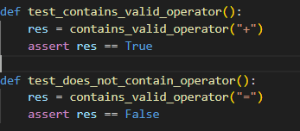
Testing: Input Handling
Accept input
Input must be 1 or 2 digits
Input must contain valid hexadecimal numbers
Input must include a valid operator (+, -, /, *)
Notes:
Moving on to our second category, input handling.
This is where we ensure the values sent to our arithmetic operations are valid.
The same steps discussed and used will also be used in this scenario, where we create test cases to check that valid input will return the correct result.
This category will use separate functions for each point identified, and the failure cases can also be included now.

Slide 12
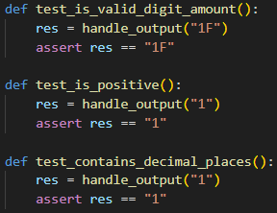
Testing: Output Handling
Return and display output
Output must be less than 5 digits (<=4)
Output must not be negative
Output must not contain decimal places
Notes:
Now, moving on to our third category, output handling.
This is where we ensure the values returned from our arithmetic operations are valid.
Again, the same 3 steps discussed will also be used in this scenario.
This category will only discuss the success cases for now, as failure cases will be handled in the error handling section.

Slide 13
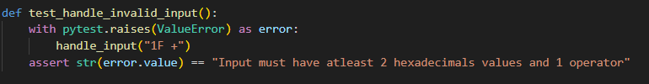
Testing: Error Handling
Invalid hexadecimal input must return an error
Missing or invalid operator must return an error
Input exceeding 2 digits must return an error
Division by zero must return an error Output that is greater than 4 digits will return an error
Output that is negative will return an error
Output with decimal places will return an error
Notes:
And finally our last category: Error handling.
This category ensures errors are raised correctly, from arithmetic operations to output handling.
Each case listed must be tested to ensure an error is raised.
These test cases use pytest.raises and tells pytest that I expect this code to raise a ValueError.
If it does, the test passes.
If it does not raise anything, or raises the wrong error, the test fails.

Slide 14
Next Step
Drafting the code
Notes:
Test cases have been written.
The next step is to draft the code to ensure all these test cases pass.

